Slide 1
Historical theory of domestic abuse
Dr Bianca Petkova, Women’s Aid
http://coercivecontrol.ripfa.org.uk

Slide 2
Theoretical understanding and practice
The way we understand domestic abuse (DA) informs what we do about it.
If we understand DA as the problem of ‘faulty’ individuals - we might try to fix, control or punish these individuals.
If we understand DA as a family issue – we might try to correct family dynamics.
If we see DA as a social problem – we might try to change ourselves and the world we live in.
Notes:
It is useful for practitioners to have an understanding that ‘theories’ are not necessarily impartial & ‘objective science’ – rather they all embody particular worldviews and tend to inform our own practice in a complex web of social power relations.

Slide 3
Theories about domestic abuse state it is due to…
Some examples:
Social learning theory (learning; modelling, reinforcement, rewards, 'intergenerational cycle of abuse; ‘learnt helplessness’ etc.)
Personality traits / disorders (e.g. narcissistic personality; psychopathology, PTSD etc.)
Family conflict theories (e.g. role conflicts, conflict over scare recourses, provocation ‘general strain theory’, etc.)
Attachment theories (enacting insecure attachments ,‘trauma bonding’, ‘Stockholm syndrome’ etc.)
Biological and evolutionary factors (biological sex predispositions, hormones, innate drives, ‘mate retention theory’ etc.)
Psychoanalytic approaches, (masochistic tendencies in women, fragile masculine identities, Oedipal complex issues, ‘Big ‘M’ theory etc.)
Ecological model – (connects domestic violence with individual, relationships, family, community & societal factors)
Feminist theories - (domestic abuse is an expression of women’s oppression in society & it is a means of maintaining gender inequality)
Intersectionality – (domestic abuse should be understood by combining gendered axes of power with others such as race, dis/ability, age, class, sexuality)
Notes:
There are many theories about DA developed by academics working from within different (philosophical or epistemological) perspectives – for example, some work from the perspective that human behaviour is learnt incl. abusive behaviour; others work from the perspective that human behaviour is bound in biological & evolutionary factors. Bio-evolutionary theories often explain male violence against their female partners as pre-programmed behaviour with a survival value.
Many early theories about DA now appear inadequate – telling us more about prejudice & power inequalities existing at the time when the theories were produced, rather than actually telling us about the origin, nature, purpose & dynamics of DA
Theories about DA change over time, although many remain faithful to their original (philosophical or epistemological) perspective
Today, theories about DA can also justify existing social inequalities and can have the effect of re-producing unequal (gender & other) power relations.
For such reasons, it is useful for practitioners to have a degree of critical awareness when adhering to or deploying particular theories in their practice. (Some questions that could be asked are: Where does the theory I use come from? Historically, to what practices did it lead? Who did it most benefit?)

Slide 4
Theories of DA can be organised in 3 main groups:
Individual centred
Socio - cultural
Family centred
Notes:
The majority of theories on slide 2 fit in one of the above areas

Slide 5
Ecological model of domestic abuse
Bronfenbrenner U (1979) Ecology of Human Development: Experiments by Nature and Design. Cambridge: Harvard Univ. Press. Cited in Dahlberg LL, Krug EG (2002) ‘Violence-a global public health problem’. In Krug E, Dahlberg LL, Mercy JA, Zwi AB, Lozano R (eds) (2002) World Report on Violence and Health. Geneva, Switzerland: World Health Organization.
Notes:
The ecological model attempts a holistic explanation of DA. In some ways it is comparable to the extended (cultural) power and control wheel, although it is less focussed on domestic abuse and it can be applied to many different social issues. The next slide offers an application of the ecological model to the issue of domestic abuse.

Slide 6
Ecological model of domestic abuse
Individual - biological and personal history factors; such as age, education, income, substance use, or history of abuse, that increase the likelihood of becoming a victim or perpetrator of violence.
Relationship - Examines close relationships that may increase the risk of experiencing violence as a victim or perpetrator. A person’s closest social circle-peers, partners and family members-influences their behaviour and contributes to their range of experience.
Community - Explores the settings, such as schools, workplaces, and neighbourhoods, in which social relationships occur and seeks to identify the characteristics of these settings that are associated with becoming victims or perpetrators of violence.
Societal - Looks at the broad societal factors, such as health, economic, educational and social policies, that help create a climate in which violence is encouraged or inhibited and help to maintain economic or social inequalities between groups in society.

Slide 7
How did it all begin? - Historical roots to domestic abuse explanations
Notes:
A review of the historical roots of domestic violence can help with the deepening of our understanding of the ways in which many current attitudes, believes and social practices mirror their historical roots and continue to be implicated in the reproduction of gender inequalities (of which domestic abuse is one example).

Slide 8
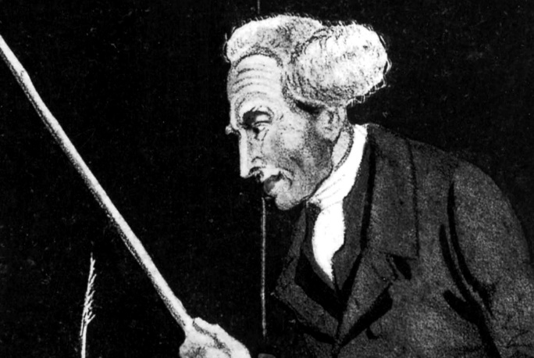
Long western tradition of legitimising control & violence against women within the family
Roman law gave men the right to chastise their wives, even to the point of death.
(Stedman B (1917) ‘Right of Husband to Chastise Wife’. Virginia Law Register 3 (4) 241).
Until late nineteenth century, English common law “gave the husband the right to “command his wife’s obedience, and subject her to corporal punishment or ‘chastisement’ if she defied his authority.”
(Tuerkheimer, 2004, citing Siegel, 1996)
1857, Rule of Thumb
A judge reportedly states that a man may beat his wife so long as he uses 'a rod not thicker than his thumb'. Many people consider this to be common law throughout the 19th century.
Notes:
Many perpetrators of domestic abuse today still carry these ‘ancient’ attitudes, often assuming a position of power in the family and carrying a sense of entitlement.

Slide 9
1960s
The term domestic violence did not exist.
Judges and police officers viewed wife beating as a trivial offense—both would tell husbands to calm down and wives to stop annoying them.
Psychiatrists saw DA as a pathology of individual (defective) men and women.
Notes:
Changes in attitudes and practices towards domestic abuse are gradual. While, eventually people began to agree that DA is a problem and it is wrong – for a number of decades victims were consistently blamed and generally the pervasiveness of the problem of DA was denied – relegated to just few cases of ‘mentally defective’ individuals.

Slide 10
1970s + Biology normalising male abuse
‘women are naturally (i.e. biologically) programmed to be quiet and passive, while men are wired biologically to be aggressive and dominant. By this they meant that men and women are biologically predisposed to be different, to the extent that women are quiet while men are aggressive’. (Tiger and Fox, 1972)
Notes:
Biological theories have tended to be particularly adept at ‘normalising’ the status quo of male violence against women. Such theories tend to pay little or no attention to the social context and power imbalance between women and men.

Slide 11
More justifications of male abuse
‘ in nearly 75 % of the cases…involving serious marital discord, particularly wife beating, the abuser typically reveals an abnormal blood glucose level’. (Hungerford cited in Dobash & Dobash, 1992: 236)
‘the primitive rage reactions leading to aggression and battering are ….instinctual patterns. Angry and aggressive responses are wired in the mammalian brain...’ (Deschner JP (1984) The Hitting Habit. New York Free Press)
Buss (1988) argues that males have developed strategies for mate retention. These include direct guarding, (restricting her movements) of the female and negative inducements to prevent her straying (financial control, threat of violence if they are unfaithful or even so much as look at another man, etc.)
Notes:
Academic literature contains many examples of pseudo-scientific justifications of male violence. There is no current research that would back findings regarding higher sugar levels in perpetrators, for example. However, other modern theories continue to justify male aggression against their female partners with supposedly ‘natural’ predispositions. Davis Buss for example, is an influential contemporary psychologist who has proposed the above ‘mate retention’ theory. Such theories enter mainstream culture and contribute to acceptance of DA.

Slide 12
1970s - Victim blaming
‘the victim in spouse assaults can always be assumed to have played a crucial role in the offence, and may have directly or indirectly brought about or precipitated their own victimisation’
(Schultz L G (1960) ‘The wife assaulter’. Journal of Social Therapy 6. (2) 103-12.)
‘the victim is the one who is acting out, initiating the interaction between her and the offender, and by her behaviour she generates the potentiality for criminal behaviour of the offender and triggers this potentiality, if it exists before in him.‘
(Amir M (1971) Patterns of Forcible Rape. Univ. of Chicago Press, 259)
Notes:
While male violence has been explained away or justified – in academic literature we find a wealth of theory and research which blames the victim. Although ‘provocation’ theories are not particularly exposed by academics today – beliefs that female victims of DA ‘provoke’ men are still widespread. Within counselling & therapy many victims of DA are still asked today, ‘What did you to make him angry?’.

Slide 13
‘What is surprising is the enormous effort to explain male behaviour by examining characteristics of women.’
(Hotaling and Sugarman, 1986)

Slide 14
1970s also marked the beginning of the women’s movement
The movement questioned gender roles, (i.e. that men should be in control of women in the family and in generally; it produced in depth analysis of gender & power).
The movement produced evidence that DA of women was prevalent , (Women’s Aid coined the term ‘domestic abuse’ & the UK government accepted it.).
DA could no longer be explained away easily by ’faulty’ individuals or ‘dysfunctional families’ – it was endemic to society.
Out of this work- Women’s Aid refuges for DA abuse victims came into being.

Slide 15
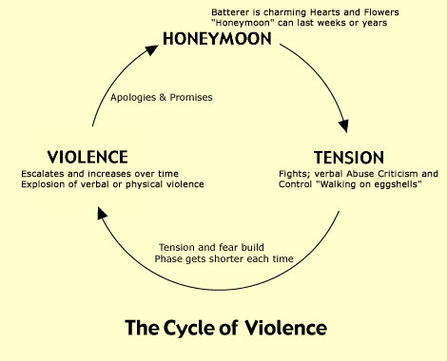
1970s and 1980s
Lenore Walker ‘cycle of violence’*
Notes:
Lenore Walker is also known for concepts such as ‘battered wife syndrome’ & ‘learnt helplessness’. Both of these concepts have been criticised for pathologising victims of DA and representing the effects of oppression as if they were an individual failing or deficiency.

Slide 16
Criticisms:
It doesn’t show intention (to exercise power & control as a motivating factor for perpetrators).
Many women don't experience ‘honeymoon’ period (culture also important).
Many women exist in a state of an ongoing fear & anxiety and experience unrelenting control over every aspect of their lives
Dobash & Dobash, 1992:226

Slide 17
1980s until today – social sciences models
Many of the theories on slide 2 have their own history of development – they have not ‘disappeared’. Today they still inform different understandings and practices in relation to DA. For example:
Individual pathology – (for e.g. a judge may give a light sentence on a male perpetrator of DA who had murdered his wife due to his ‘depression’)
Family conflict – (for e.g. both parties can be conceived ‘as bad as each other’ by various professionals)
Instinct theories of human aggression – (for e.g. male violence against female partner can be considered understandable due to provocation by the victim)
(For comprehensive discussion see:
http://www.lsc.vu.lt/assets/leidiniai/index60c0.html?show_content_id=392 - Dr. Jolanta Reingardienė - Historical and Theoretical Discourse Surrounding Gender Based Violence Research

Slide 18
1980s until today – feminist models
Feminist models continue to draw on survivors’ experiences and to view domestic abuse as an instrument and expression of gender inequality.
Analysis of coercive control were developed over the years, (e.g. Albert Biderman 1950s, Susan Schechter 1970s, Evan Stark, 1990s) to enrich practitioners’ understanding of abusive practices and of the nature and dynamics of domestic abuse.
The Duluth Domestic Abuse Intervention Project in Minnesota developed the multi-agency Coordinated Community Response (see the ‘What works’ guidance sheet for more information) to DA. Power and Control wheels were developed and implemented as a guiding tool in their work and this has been adopted by many DA practitioners world wide.
Intersectional models of DA added further dimensions to practitioners' understanding of multiple forms of discrimination and abuse of people from marginalised groups. These models became particularly useful for highlighting ways in which other (than gender) sources of power impact on victims – for e.g. ethnicity/ race, ‘ablebodyism’, age etc.

Slide 19
Conclusions
Knowledge of the history & diversity of domestic abuse theories is important because, it can help practitioners to:
Have a fuller understanding of the perspectives on domestic abuse they are working from within.
Have an increased critical awareness of some of the ways in which particular theories might impact on the very people they support and more broadly on communities & society.
Be more confident in selecting appropriate theoretical perspectives.
Be more able to develop a more holistic understanding of the problems faced by the people they support.
You can find out more about the Coordinated Community Response and the Power and Control Wheel, and theories of coercive control in the overarching resources section of http://coercivecontrol.ripfa.org.uk/, specifically Guidance Sheet Three: What works? These are the models on which the majority of UK interventions have been based.
The ‘Reflections on our ways of knowing’ tool may also be useful to promote reflection:
http://coercivecontrol.ripfa.org.uk/wp-content/uploads/Case_Study_1-Tool2-reflection_on_our_ways_of_knowing.pdf

